Slide 1
ME623 Dynamics of Machining Processes
Group No:34
SIMULATION AND ANALYSIS OF ORTHOGONAL CUTTING
DUDALA RAJANIKANTH (234103416)
KONAPALA SAI SRAVAN (234103421)
B BHASKAR (234103412)

Slide 2
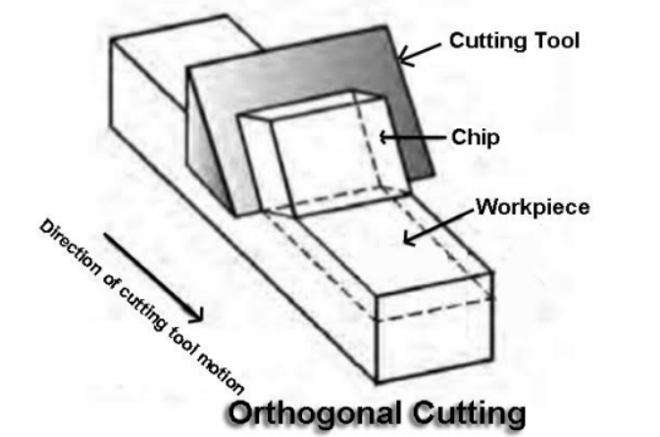
Introduction, Objectives and Methodology
Orthogonal cutting is a type of cutting in which cutting takes place such that cutting edge of tool is always perpendicular to cutting velocity.
OBJECTIVES:-
The basic objectives here are
we are depicting variation in
stresses with respect to
change in rake angle and
depth of cut which tells us the
power consumption.

Slide 3
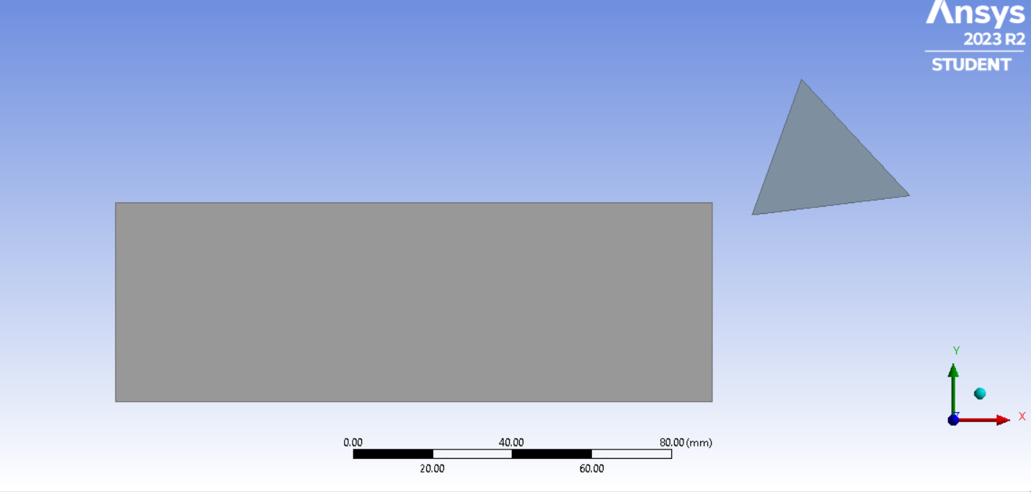
Introduction, Objectives and Methodology
METHODOLOGY:-
For calculating this variations in stresses we are taking the help of ANSYS software.
The materials primarily used here are Tungsten for tool and Al 7075-T6 for workpiece.
The dimensions of workpiece taken are 150*50*40mm.
Firstly, the rake angle of tool is taken as 20°,10° for depth of cut of 3mm. Then, depth of cut is taken 2mm and 4mm at rake angle of 5°, to calculate stress variation.

Slide 4
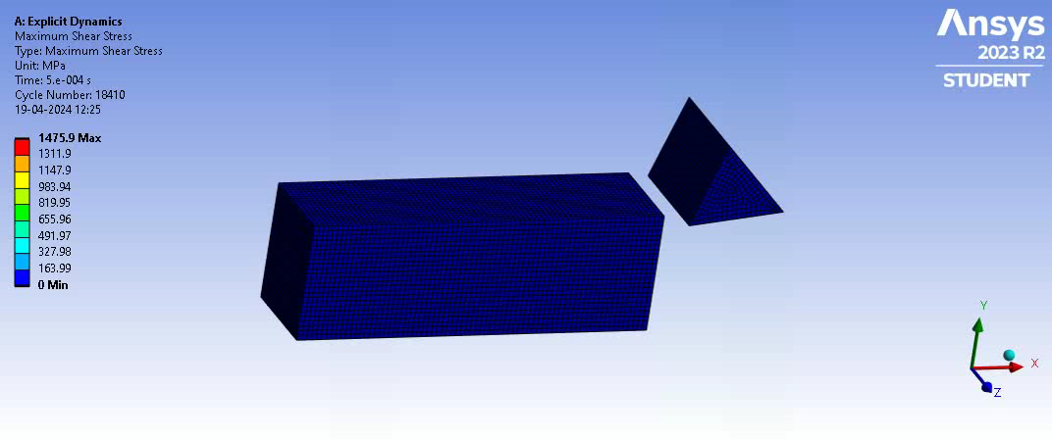
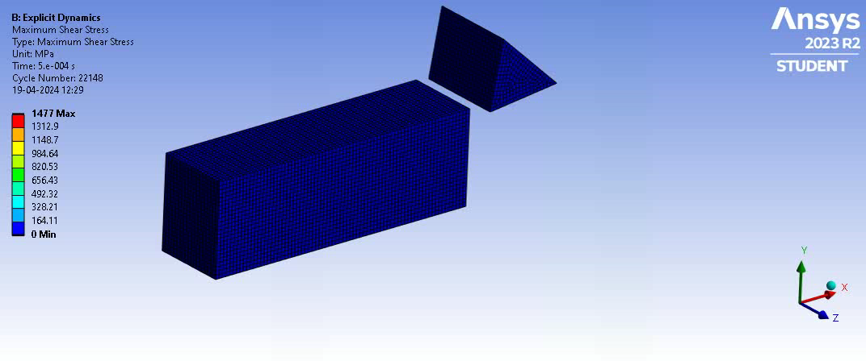
Results and Discussions
Rake angle | Depth of cut(mm) | Max. Shear stress (MPa)
20° | 3 | 1039.3
10° | 3 | 1041.8

Slide 5
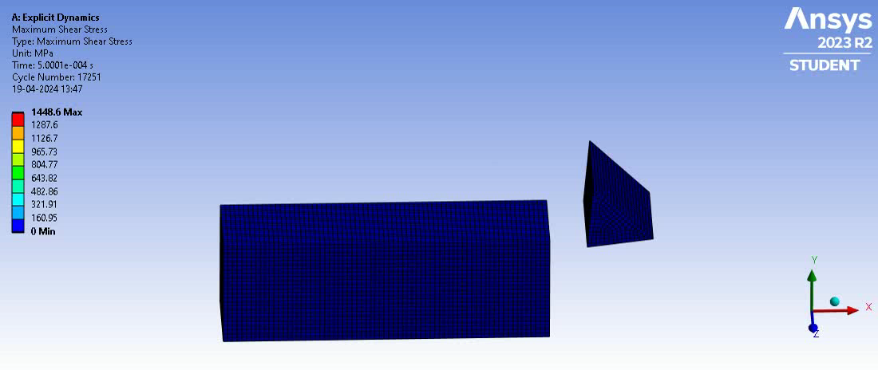
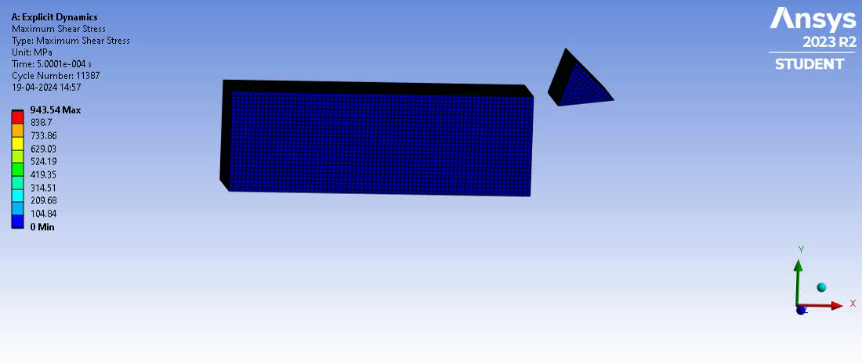
Results and Discussions
Depth of cut | Rake Angle | Max. Shear stress (MPa)
2mm | 5° | 998.23
4mm | 5° | 1009.8 MPa

Slide 6
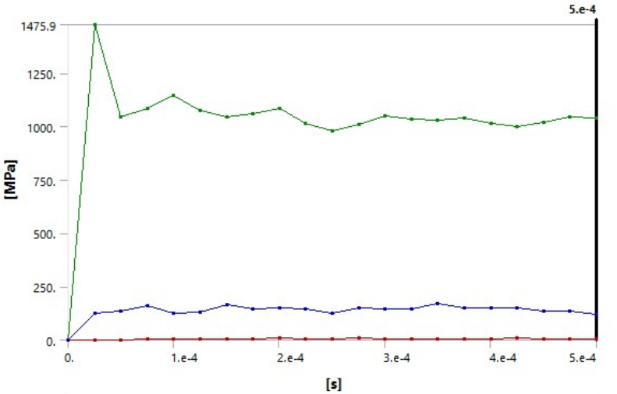
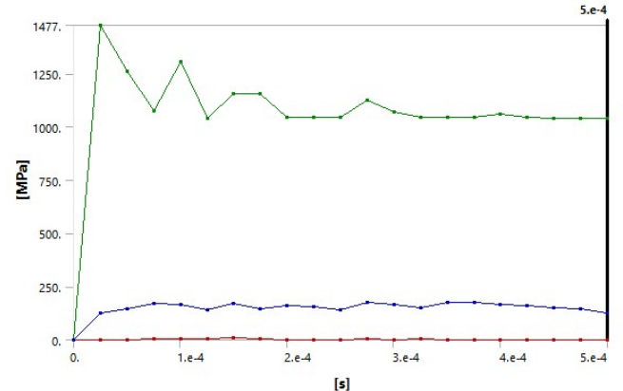
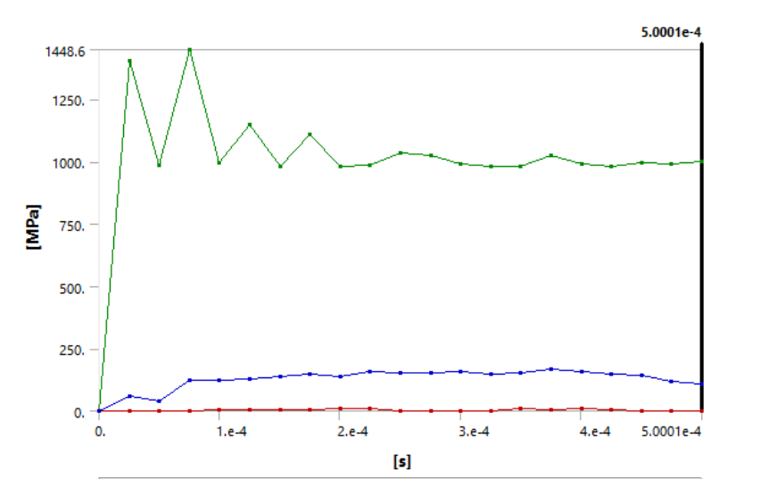
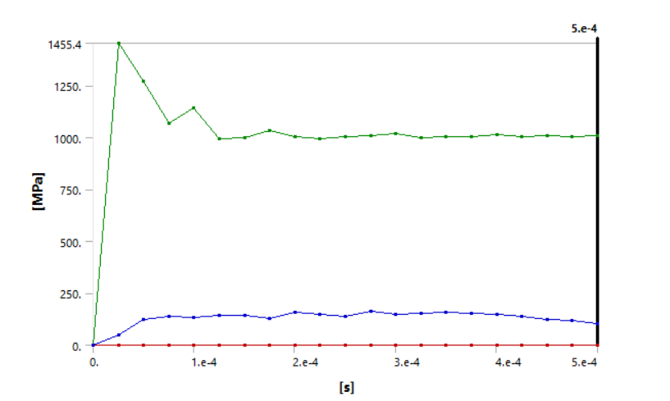
Results and Discussions
Shear stress vs time for 20° rake angle
Shear stress vs time for 10° rake angle
Shear stress vs time for 2mm depth of cut
Shear stress vs time for 4mm depth of cut

Slide 7
Conclusions
After comparing stress values for various rake angles, we can conclude that as the rake angle increases, the shear stress reduces.
After comparing stress values for various depth of cut , we can conclude that as the depth of cut increases, the shear stress increases.

